Slide 1

State of Security
Notes:
State of Security
Pigeon
When thinking about security one thing always comes to mind. “Security must be baked in and not bolted on.” Our team has really taken that into consideration each step of the project and thought about security as we built instead of as an afterthought. We also thought about Integrity the ability for others to modify your data. Confidentiality the ability for others to view your data that hasn’t been explicitly shared with them. The availability of data or denial of access is really where we cover all these pieces. Since we will be calling functions to retrieve data from a database full of user information there are several steps, we have taken to secure this data, and verify that only the users that should have access to this data have access.

Slide 2
User Information Security
Database Assertion Functions
Verify who the user is, and this users ID is what is used to verify all data access.
Unique Usernames and User IDs
Because so much about the user is unique it makes securing user data simple.
Messages
Assertions for User Role, Permissions, Group Access
Symmetric Message Encryption
AES 256 bit with Padding
DBMS_CRYPTO
To change an aspect of the message we assert that the user is the owner (“removing messages”)
Notes:
User Information Security
Identification, Authentication, Authorization
Database Assertion Functions:
To gain access to any user data you must be logged in as a user on the site. This is done through a login portal. The user that you logged in as is what is used to verify any further access to data. We use the user’s ID, which is unique to each user, to check whether they have access to data from group chats of users, messages, and other types of user stored data that should be accessed.
Messages:
First, we verify that the user asking for access has permission to view a message, and that they are in the group with the message. Because of this if a user is not in a group, they would access to no messages until they were added to a group. We also assert that a user is the owner of a message, and this assertion will be used with setting message permissions and removing the message. Messages are stored using symmetric AES 256-bit encryption. And only decrypted from a database call using all the previous mentioned verifications to check that the user is in the group and has access within the group.
Symmetric Encryption:
The encryption key is different for every group and is not shared to the web application at any point.

Slide 3
Login Security
Password Security
Passwords will have required length of 8.
Login Attempts
Max login attempts will be set to 5 to prevent brute attacks.
Password Recovery
User can reset their password using a code that will expire 24 hours after is set or immediately upon their next successful login.
Padding and Username
Passwords are stored in hashes and compared to allow the password to be hidden from view and never stored in plain text.
Notes:
Login Security Expanded
Password Security:
User passwords are never stored in plane text. When registering or changing a password the user password is sent to the database and hashed using 128-bit padding, their username and password. This hash, which cannot be reversed, is used to compare every-time the user logs in to the website. The user’s password has a required length of 8 characters. No other requirements are currently in place, so users have complete control of their password’s security and convenience.
Login Attempts:
In order to prevent a brute force, attack we have set a maximum login attempt amount of 5. After reaching his amount the user’s login attempts will be temporarily suspended.
Password Recovery:
If the user has forgotten their password, we allow a 2-factor password reset using the user’s username, and a code sent to their email. This code is reset after 24-hours or immediately upon their next login.

Slide 4
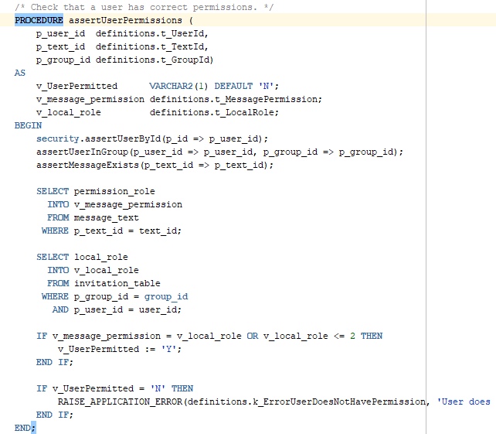
Database Security
Database password changed every 30 days
Assertion Functions
Validation
Unique
Unique Identifiers
DBMS_CRYPTO
Hashing
AES 256-bit Encryption
Notes:
Database Security Expanded
Database Security:
Database Password is changed every 30 days.
Assertion Functions:
We use assertion functions when sending data and receiving data from the database. We have procedures on account creatin to verify that a username and email are unique. Other procedures verify that a user is allowed to access certain data.
DBMS_CRYPTO:

Slide 5
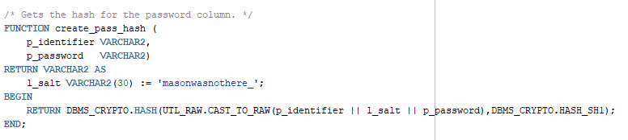
DBMS_CRYPTO Password Hashing
Notes:
Hashing:
Our hashing function uses DBMS_CRYPTO. Hash() which takes in the raw data, and the hashing type and returns the hash we compare all user passwords to that is stored in database.

Slide 6
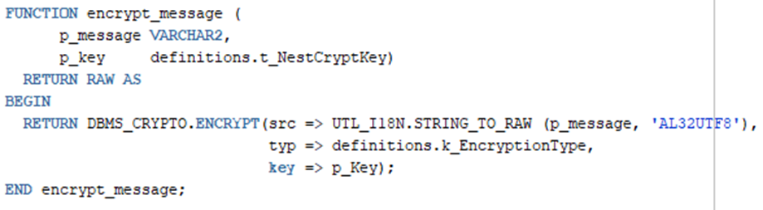
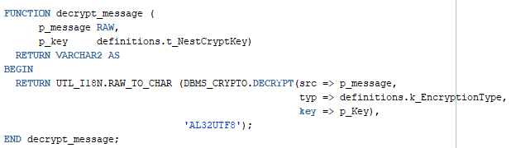
DBMS_CRYPTO Encrypt/Decrypt
Notes:
Encrypt: Our encrypt function uses DBMS_CRYPTO.Encrypt() which takes in the raw data converted from the message, the type of encryption we are using AES 256-bit, and the encryption key associated with the group that contains the message.
Decrypt: Our decrypt using DBMS_CRYPTO.Decrypt() takes in the same parameters, and we would be taking in the raw encrypted text.

Slide 7
C# and ASP Security
Use of Data Bind Variables to Take Only What We are Looking for When Sending Code to the Database.
PL/SQL Anonymous Block
Obfuscated Password Text Box
Message Boxes Will be Locked until Clicked
Notes:
C# and ASP.NET Security
Front End Security:
Use of Data Bind Variables to Take Only What We are Looking for When Sending Code to the Database.
PL/SQL Anonymous Block
Obfuscated Password Text Box

